Slide 1
WiFi Booster Impact
Stanislav Babenyshev
19.06.2026

Slide 2

Executive Summary: Targeted rollout unlocks CHF +20.7M
Recommendation
✓ Roll out booster to Extreme internet users
✗ Do not extend to full customer base
✓ Validate with a randomized A/B test before scaling
 | Cost | Saved rev. | Net
Extreme users | CHF 8.7M | CHF 29.4M | CHF +20.7M
Full base | CHF 52.5M | CHF 30.5M | CHF −22.0M
Extreme users capture 96% of the saved revenue at 17% of the cost.

Slide 3
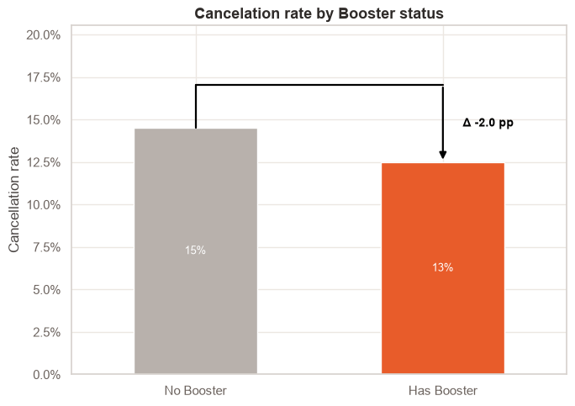
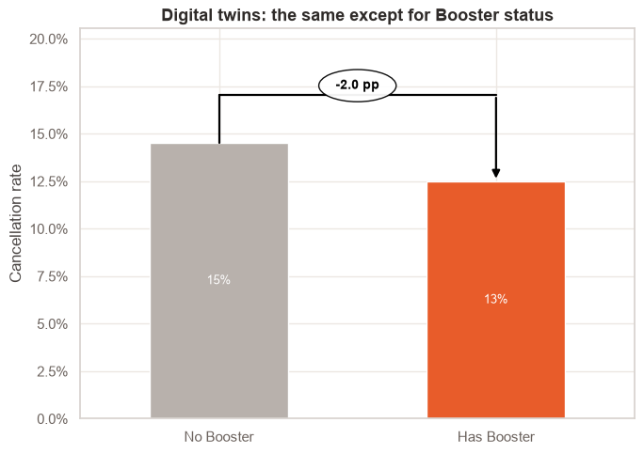
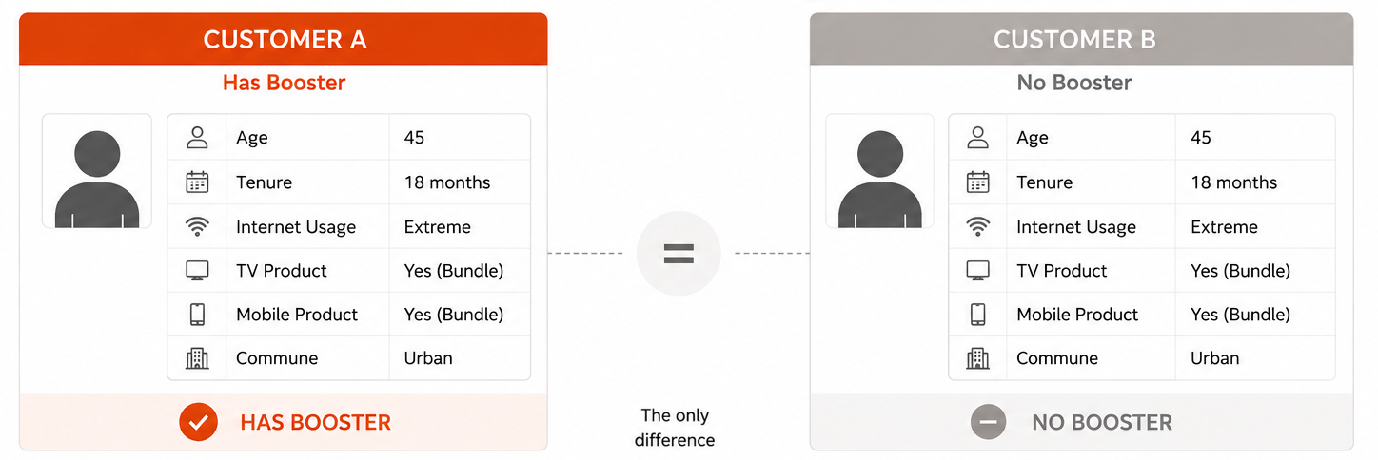
How much does the booster reduce cancelation?
Overall comparison
Raw averages — does not correct for self-selection
Corrected (“Like-for-like”) comparison
Two independent methods cross-check the estimate
Logistic Regression (AME): −1.0 pp
Digital Twins (PSM, ATT): −1.6 pp
Two independent methods confirm: the booster effect is real, but substantially smaller than raw comparisons suggest.

Slide 4
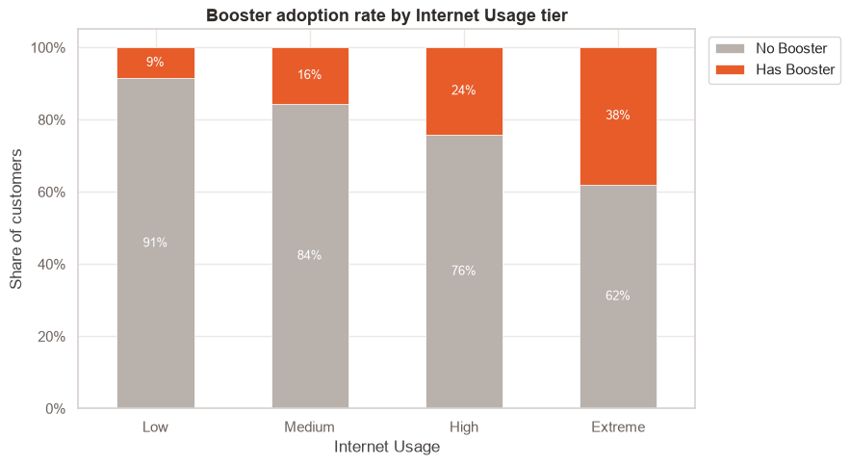
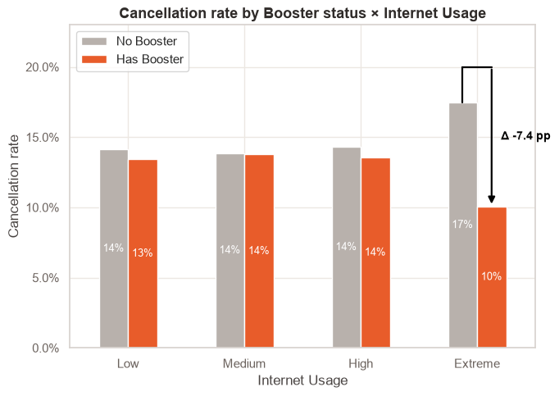
Heavy users self-select into the booster
The apparent overall benefit comes mostly from the fact that heavy users choose the booster.
Raw comparison is misleading — heavy users self-select into the booster, inflating expected benefit.

Slide 5
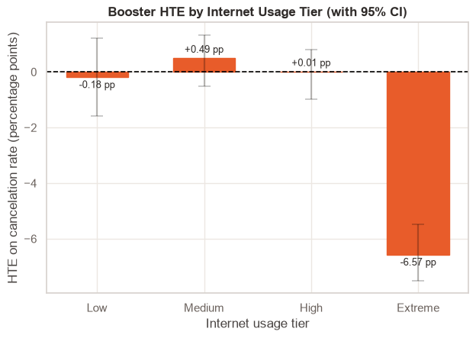
Extreme internet users drive the entire booster effect
HTE (Heterogeneous Treatment Effect) answers: “For a customer with specific characteristics, how much does a cancelation probability change if that customer has or has not a booster, while everything else stays the same?”
Segment | Customers | AME
Low usage | 24% | −0.2 pp
Medium usage | 34% | +0.5 pp
High usage | 28% | 0.0 pp
Extreme usage | 17% | −6.6 pp
Only Extreme internet users show a statistically significant effect — the other segments show no meaningful cancelation rate reduction.

Slide 6
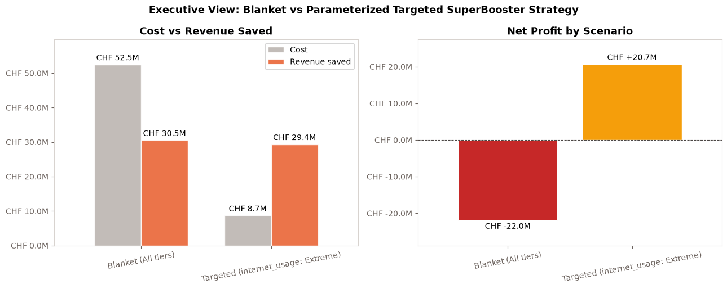
Targeted vs. blanket: CHF +20.7M vs. CHF −22M

